Slide 1

Key Elements of a Winning Presentation
Image Source: Copilot (September 25, 2024)

Slide 2
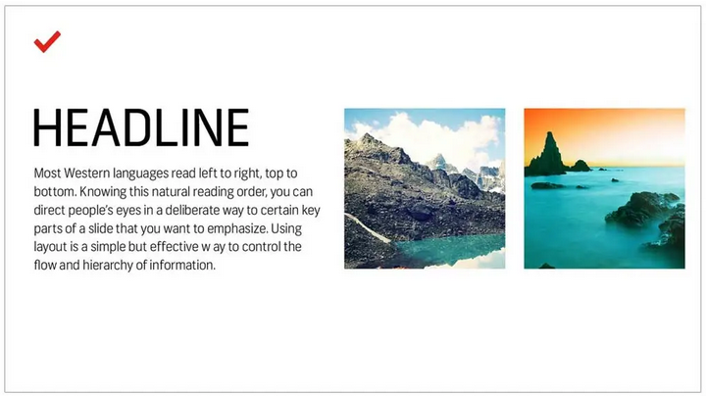
Use Layout to Your Advantage
Tip 1: Control the flow and visual hierarchy of information.
Design Tip: Use templates for structured, clear slides.
Example: Images on the right, headline text on the left.

Slide 3

Avoid Sentences
Tip 2: Slides are visual aids, not scripts.
Guideline: Use keywords, not full sentences.
Design Tip: Leave the full message for the speaker to deliver.
Example: Bullet points over paragraphs.

Slide 4

Follow the 6x6 Rule
Tip 3: Avoid clutter with the 6x6 rule.
Guideline: Maximum 6 bullet points per slide, 6 words per bullet.
Design Tip: Use white space to enhance focus.
Example: No overcrowded text.

Slide 5
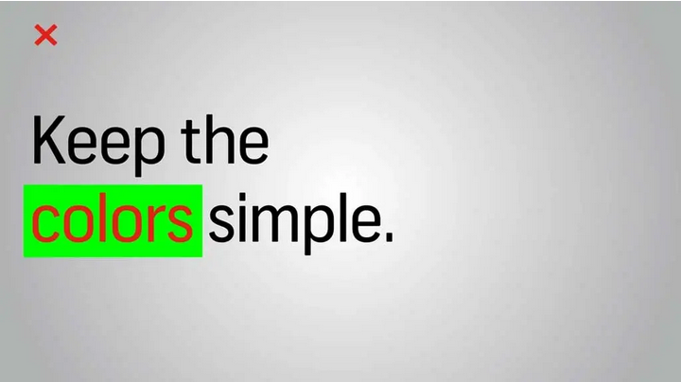
Keep the Colors Simple
Tip 4: Stick to basic, opposing color schemes.
Guideline: Light text on dark background or vice versa.
Design Tip: Avoid eye fatigue with bright colors.
Example: Red and white color palette vs. gray and neon green.

Slide 6
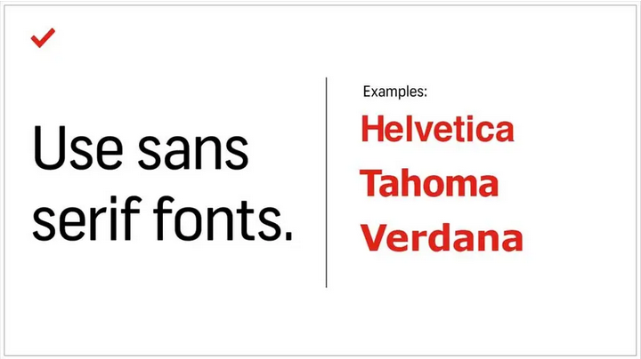
Use Sans-Serif Fonts
Tip 5: Prioritize readability on screens.
Guideline: Use sans-serif fonts (e.g., Helvetica, Tahoma).
Design Tip: Stick to one or two fonts for consistency.
Example: Sans-serif over serif fonts.
Additional Information: Wikimedia Foundation. (2024a, July 17). Sans-serif. Wikipedia. https://en.wikipedia.org/wiki/Sans-serif

Slide 7

Stick to 30pt Font or Larger
Tip 6: Ensure readability with large fonts.
Guideline: Use a minimum of 30pt font size.
Design Tip: Large fonts help limit text, forcing clarity.

Slide 8

Avoid Overstyling the Text
Tip 7: Keep text styling simple and clear.
Guideline: Use bold, italics, or color sparingly.
Design Tip: Over styling distracts, simplicity engages.

Slide 9

Choose the Right Images
Tip 8: Images should support and elevate your message.
Guideline: Opt for relatable, authentic, and inspirational visuals.
Design Tip: Avoid generic images that don't connect emotionally.
Source: View palm trees sky aircraft flying stock photo 1016363830 | shutterstock. (n.d.). https://www.shutterstock.com/image-photo/view-palm-trees-sky-aircraft-flying-1016363830

Slide 10
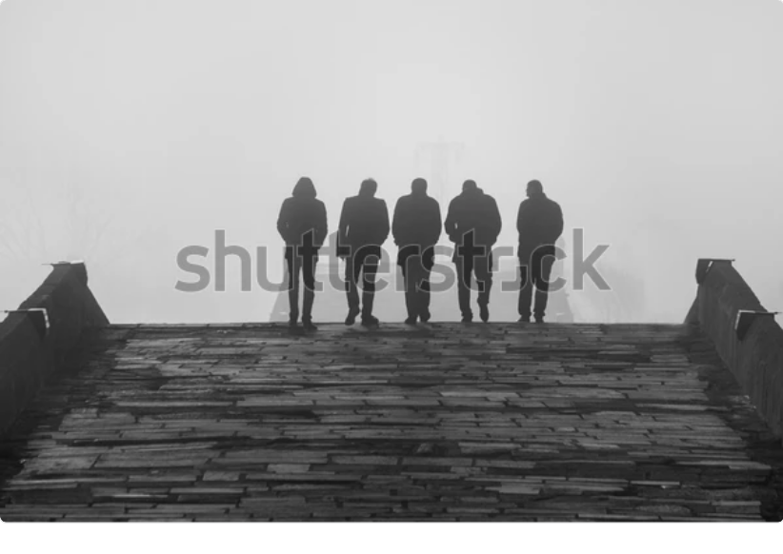
Additional Image Considerations
Tip 9: Ensure high resolution for projected presentations.
Guideline: Compress images correctly for uniform quality.
Design Tip: High-resolution images maintain professionalism.
Source: Human black and white: Over 838,739 royalty-free licensable stock photos | shutterstock. (n.d.-a). https://www.shutterstock.com/search/human-black-and-white?image_type=photo

Slide 11
Key Takeaways
Simplicity is key – less is more.
Effective design keeps the audience engaged and focused.
Source Article: Aaron White, Alyssa Goulet. “How to Make a Beautiful Powerpoint Presentation: A Simple Guide.” The Shutterstock Blog, 26 July 2024,
www.shutterstock.com/blog/tips-on-how-to-make-effective-beautiful-powerpoint-presentations

Slide 12

THANK YOU!
Source Article: Andrew Steele. Packard Hood Ornament, 8 September 2024, Greenfield Village (Apple iPhone 14)

